Slide 1
Probabilistic Data Structures to Store Web Traffic Data
Balaji Sukumaran
CSCI6057 Advanced Data Structures
4th April 2024

Slide 2

Probabilistic Data Structures
Large Datasets
Not Resource-Intensive
Approximate Answers Controlled Error
Near-Perfect Results
Fig 1: Probabilistic Data Structures [11]

Slide 3
Advantages
Disadvantages
Memory Efficiency
Scalability
Computational Speed
Big Data Suitability
Inaccuracy/Error Rates
Complexity
Tuning Difficulty
Limited Applicability

Slide 4
Data structures in scope..
Skip List
Bloom Filter
Cuckoo Filter

Slide 5
Skip List
Enhancing linked lists
Randomized algorithms
Express route
Concurrency

Slide 6
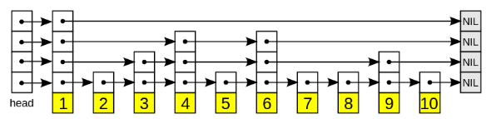
Visualizing Skip List
Fig 2: Skip List [12]

Slide 7


Properties
Height h (No of Linked List/No of levels)
Probability p
highest element will appear in lists.
For example:
- P = ½, h = (Average)
$$\log_{\frac{1}{p}}\left(n\right)$$
$$\log_{2}\left(n\right)$$
Fig 3: Skip List [12]

Slide 8
Supported Operations
Search
Insert
Delete
Fig 4: Skip List [12]

Slide 9

Time Complexity
Average:
Search : O (log n)
Insert : O (log n)
Delete : O (log n)
Space Complexity
n
n.2
O (n)
$$\sum_{\dot{i}=0}^{h}{\frac{1}{2^{i}}}$$

Slide 10
Bloom Filters
Multiple Hash Functions
False Positives ✓
False Negatives X
Space Efficient

Slide 11
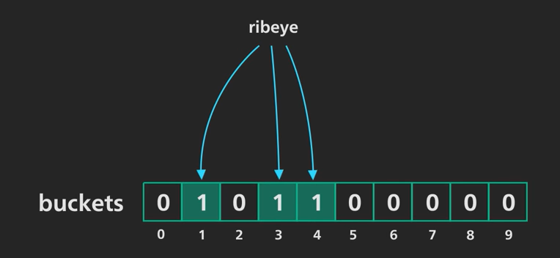
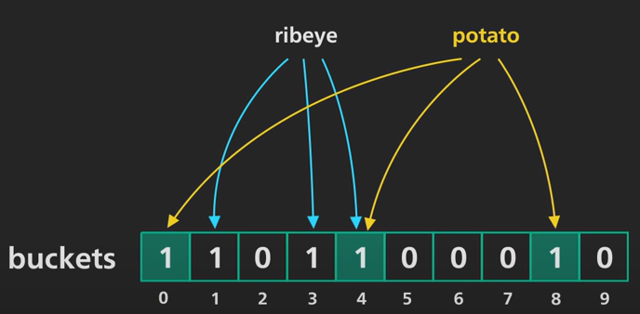
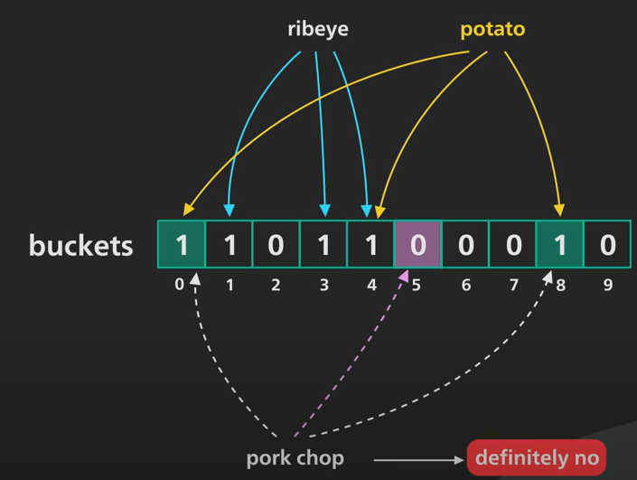
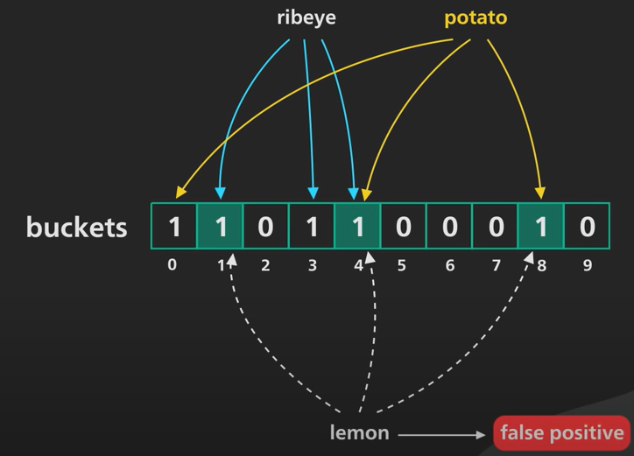
Bloom filter working…
Fig 5: Bloom Filter [14]

Slide 12





Properties
Bloom filter with m bits and k hash functions
Probability of a bit NOT set after an insertion is
After n insertion , a bit NOT set.
Probability of false positive is
The approx. value for large value of m
To minimize the false positive k = (optimal number of hash functions)
$${\left(1−\frac{1}{m}\right)}^{k}$$
$${\left(1−\frac{1}{m}\right)}^{nk}$$
$${\left(1−{\left(1−\frac{1}{m}\right)}^{nK}\right)}^{k}$$
$${\left(1−ⅇ^{−{kn}/m}\right)}^{k}$$
$$\ln\left(2\right)⋅\frac{m}{n}$$

Slide 13

Time Complexity
Search : O (k)
Insert : O (k)
Delete : X
Space Complexity
O (m)
1.44 log
$$\left(\frac{1}{FPP}\right)$$

Slide 14
Cuckoo Filters
2 Hash Functions
False Positives ✓
False Negatives X
Space Efficient
Supports Deletion
Stores Fingerprints

Slide 15
Supported Operations
Search
Insert
Delete

Slide 16
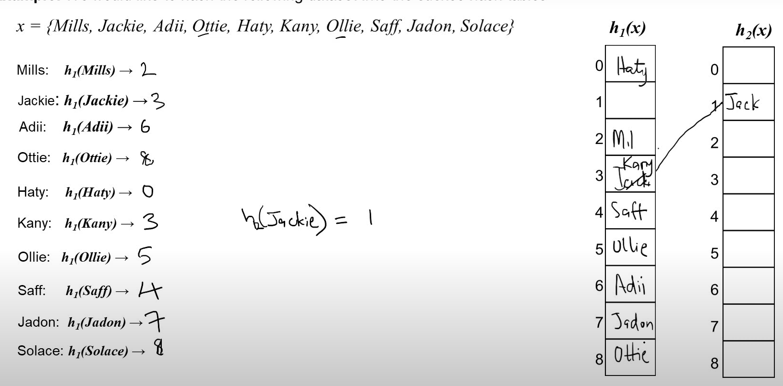
Cuckoo Hashing
Fig 6: Cuckoo Hashing [16]

Slide 17
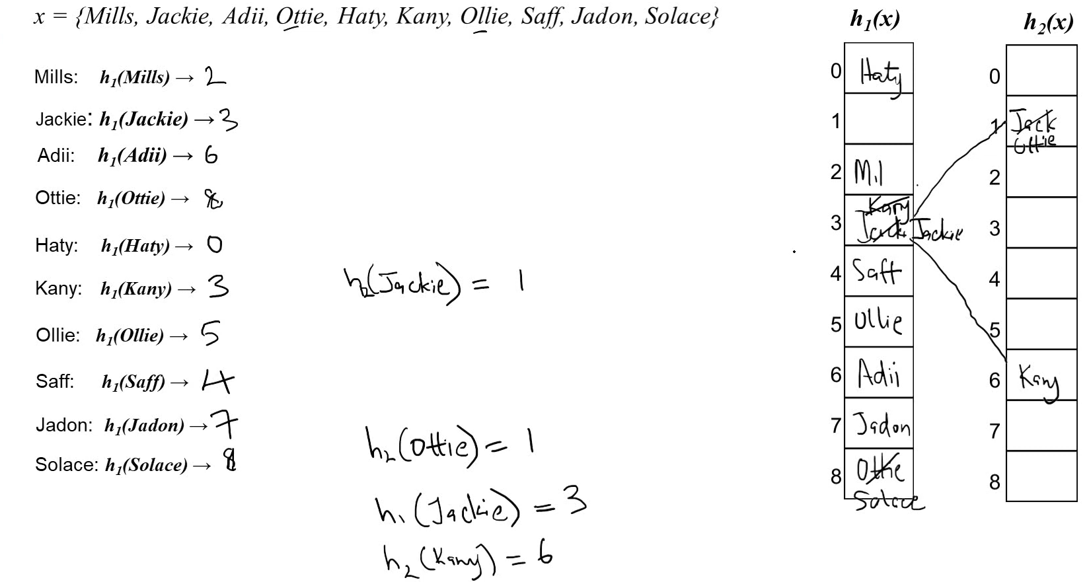
Cuckoo Hashing
Fig 7: Cuckoo Hashing [16]

Slide 18
How it is different from bloom filter?
Handle increased load ? …
Cuckoo filter maintains constant false positive rate.
Bloom filters keep inserting at a cost of rising false positive rate

Slide 19

Time Complexity
Search : O (1)
Insert : O (1) **
Delete : O (1)
Space Complexity
O(m)
2 accounts for overhead :
storing the fingerprints
maintaining the false positive rate
$$\frac{\log\left(\frac{1}{FPP}\right)+2}{load}$$

Slide 20
Previous Work: Skip List
Advancements in Concurrent Skip Lists [1][2]
Introduced efficient concurrent access to dynamic search structures. Optimized with skip lists, a probabilistic alternative to balanced trees.
Employs optimistic synchronization for lock-free searches and lock-based validations.
Facilitates simple, scalable concurrent operations with correctness proofs. Shows competitive performance even under high contention.

Slide 21
Previous Work: Bloom Filters
Innovations in Bloom Filter Applications [3][4]
Development of variable-length signatures for flow deletions.
Introduced a bank of Bloom filters for packet processing.
Content-based strategies proposed to reduce false positive rates significantly. Demonstrated potential for false positive reduction up to 79.83% in tests

Slide 22
Previous Work: Cuckoo Filters
Practical applications in cybersecurity [6], show significant efficiency gains in password cracking processes.
Theoretical guarantees on its performance.

Slide 23
Probabilistic Nature:
Skip List: Probabilistic decision to include an element at a level.
Bloom Filter: Probability of false positives. (Correctness).
Cuckoo Filter: Probabilistic aspect of cuckoo hashing. (Controlled Correctness)

Slide 24

Web Traffic Data
Clickstream data.
Characteristics ?
Vast
Unending
often sparse
Uses?
User behavior
Optimizing website design
Search engine optimization and more.
Fig 8: Web Traffic Data [1]

Slide 25
My work?
Implementing Probabilistic data structures from scratch
Loading it with clickstream data
Testing Framework to log to its performance and efficiency
Scripts to visualize the data structures efficiency

Slide 26
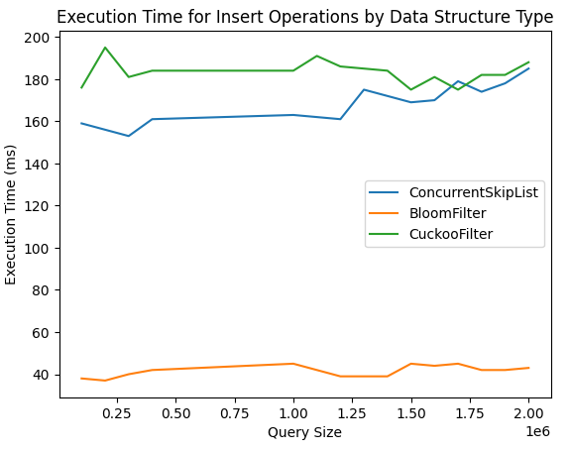
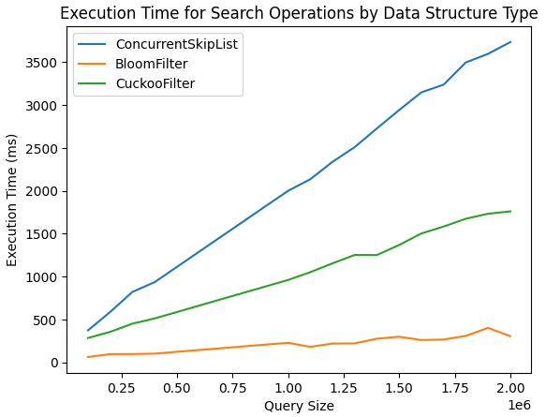
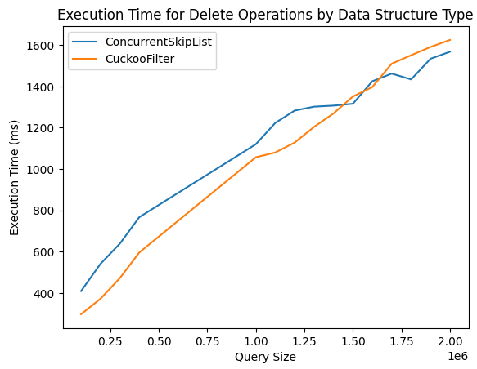
Findings? Execution Time
Fig 9: Insertion Execution Time
Fig 10: Search Execution Time
Fig 11: Deletion Execution Time

Slide 27
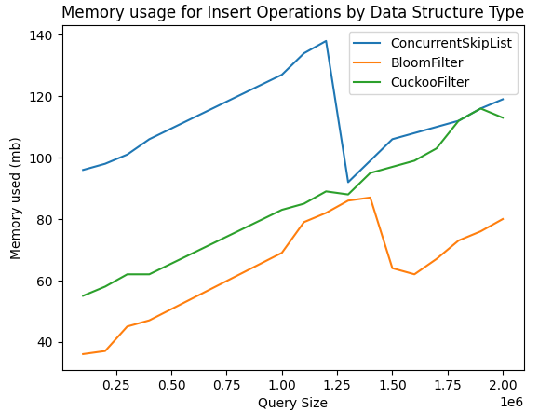
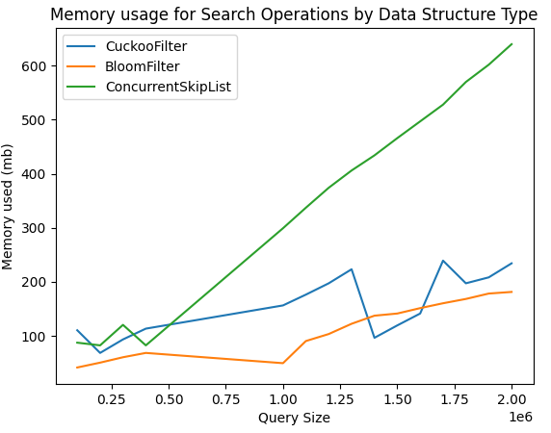
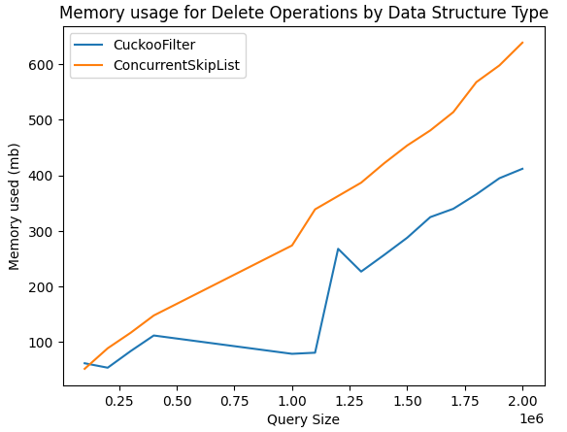
Findings? Memory Usage
Fig 9: Execution Time (Insert, Search, Delete)
Fig 11: Insertion Memory Usage
Fig 12: Search Memory Usage
Fig 13: Deletion Memory Usage

Slide 28
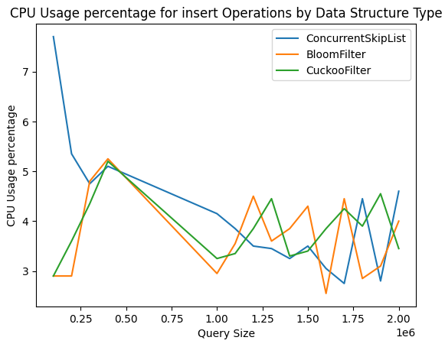
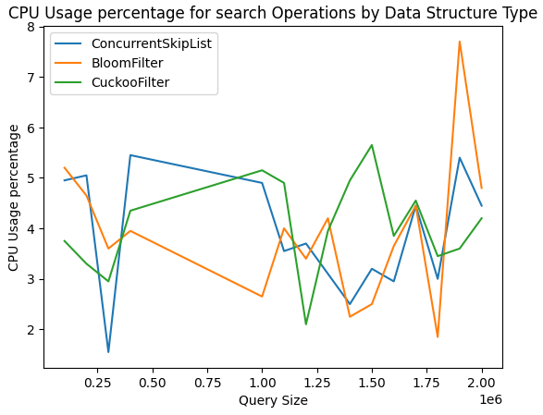
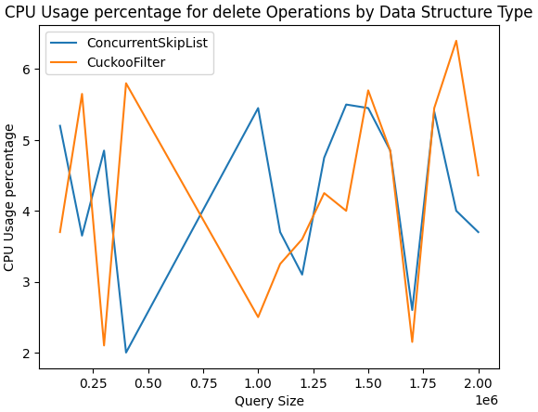
Findings? CPU Usage
Fig 14: Insertion CPU Usage
Fig 15: Search CPU Usage
Fig 16: Deletion CPU Usage

Slide 29
Conclusion
Skip List is not appropriate
Correctness is NOT a hard criteria
Not necessary to store the actual data.
Bloom Filter is the best (Exception – Deletion not required)
Best in class performance
Ability to store growing data
Cuckoo Filter is the best of both worlds
Good performance
Ability to delete data
Ability to store growing data

Slide 30
Future work
1. Expand Analytical Framework
Explore application across various domains
Adapt to database and network storage systems
Investigate tolerance levels for false positives in diverse environments
2. Product Development
Develop a comprehensive data analysis tool
Leverage current implementations as foundational elements
Tailor features for domain-specific analytics
3. Robustness and Generalization
Enhance robustness for broader application scope
Optimize performance for general use cases
Aim for an open platform usable across industries

Slide 31
References
[1] W. Pugh, “Concurrent maintenance of skip lists,” in University of Maryland at College Park, USA, 1990. Available: https://dl.acm.org/doi/10.5555/93717
[2] Herlihy, Maurice & Lev, Yossi & Luchangco, Victor & Shavit, Nir, “A Provably Correct Scalable Concurrent Skip List,” 2010, [Online]. Available: https://www.researchgate.net/publication/249902280_A_Provably_Correct_Scalable_Con current_Skip_List
[3] Lu, Yi, B. Prabhakar and F. Bonomi, “Bloom filters: Design innovations and novel applications,” 2005, [Online]. Available: https://web.stanford.edu/papers/bloom.pdf
[4] Alsuhaibani M, Khan RU, Qamar AM, Alsuhibany SA. Content-Based Approach for Improving Bloom Filter Efficiency. Applied Sciences. 2023; 13(13):7922. https://doi.org/10.3390/app13137922
[5] Bin Fan, Dave G. Andersen, Michael Kaminsky, and Michael D. Mitzenmacher. 2014. Cuckoo Filter: Practically Better Than Bloom. In Proceedings of the 10th ACM International on Conference on emerging Networking Experiments and Technologies (CoNEXT '14). Association for Computing Machinery, New York, NY, USA, 75–88. https://doi.org/10.1145/2674005.2674994

Slide 32
References
[6] Cano, MD., Villafranca, A. & Tasic, I. Performance evaluation of Cuckoo filters as an enhancement tool for password cracking. Cybersecurity 6, 57 (2023). https://doi.org/10.1186/s42400-023-00193-6
[7] Joseph Tassarotti and Robert Harper. 2019. A Separation Logic for Concurrent Randomized Programs. Proc. ACM Program. Lang. 3, POPL, Article 64 (January 2019), 30 pages. https://doi.org/10.1145/3290377
[8] Vitaly Aksenov, Dan Alistarh, Alexandra Drozdova, and Amirkeivan Mohtashami. 2023. The splay-list: a distribution-adaptive concurrent skip-list. Distrib. Comput. 36, 3 (Sep 2023), 395–418. https://doi.org/10.1007/s00446-022-00441-x
[9] Henry Daly, Ahmed Hassan, Michael F. Spear, and Roberto Palmieri. NUMASK: High Performance Scalable Skip List for NUMA. In 32nd International Symposium on Distributed Computing (DISC 2018). Leibniz International Proceedings in Informatics (LIPIcs), Volume 121, pp. 18:1-18:19, Schloss Dagstuhl – Leibniz-Zentrum für Informatik (2018) URL: https://doi.org/10.4230/LIPIcs.DISC.2018.18

Slide 33
References
[10] Using Probabilistic Data Structures in Redis. Accessed: Apr. 2, 2024. [Online]. Availability: Using Probabilistic Data Structures in Redis - Semaphore (semaphoreci.com)
[11] Probabilistic data structure. Accessed: Apr. 2, 2024. [Online]. Availability: probabilistic data structures - Google Search
[12] Skip List | Brilliant Math & Science Wiki. Accessed: Apr. 2, 2024. [Online].
Availability: Skip List | Brilliant Math & Science Wiki
[13] Bloom Filter | Brilliant Math & Science Wiki. Accessed: Apr. 2, 2024. [Online].
Availability: Bloom Filter | Brilliant Math & Science Wiki
[14] Bloom Filters | Algorithms You Should Know #2 | Real-world Examples. Accessed: Apr. 2, 2024. [Online]. Available:
Bloom Filters | Algorithms You Should Know #2 | Real-world Examples (youtube.com)

Slide 34
References
[15] How Cuckoo Hashing Work Part 1 (Introduction to Cuckoo Hashing). [Online Video]. Available:
How Cuckoo Hashing Work Part 1 (Introduction to Cuckoo Hashing) (youtube.com)
[16] Cuckoo Filter Basics. All that you need to know!!. [Online]. Available:
Cuckoo Filter Basics. All that you need to know!! | Medium

